Slide 1
INFECTIONS CAUSED BY HELMINTHS

Slide 2
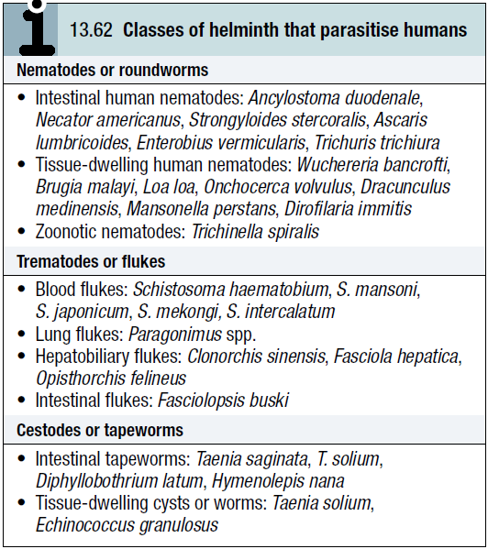
Helminths (from the Greek Helmins, meaning worm) include three groups of parasitic worm, large multicellular organisms with complex tissues and organs.

Slide 3
Intestinal human nematodes:
Diseases are caused by adult nematodes living in the human gut.
There are two types:
the hookworms, which have a soil stage in which they develop into larvae that then penetrate the host
a group of nematodes which survive in the soil merely as eggs that have to be ingested for their life cycle to continue.

Slide 4
The geographical distribution of hookworms is limited by the larval requirement for warmth and humidity.
Soil-transmitted nematode infections can be prevented by avoidance of faecal soil contamination (adequate sewerage disposal) or skin contact (wearing shoes), and by strict personal hygiene.

Slide 5
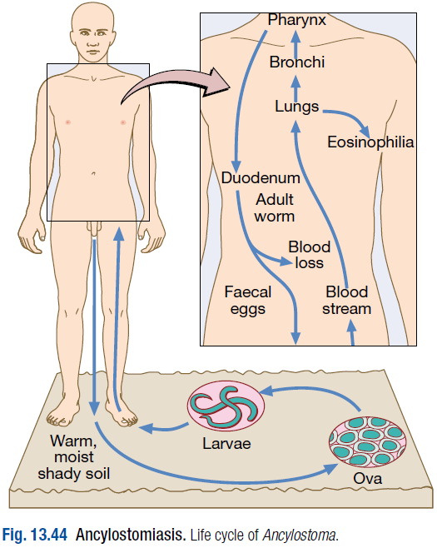
Ancylostomiasis (hookworm):
Ancylostomiasis is caused by parasitisation with Ancylostoma duodenale or Necator americanus.
The adult hookworm is 1 cm long and lives in the duodenum and upper jejunum.

Slide 6
Eggs are passed in the faeces.
In warm, moist, shady soil the larvae develop into rhabditiform and then the infective filariform stages; they then penetrate human skin and are carried to the lungs.
After entering the alveoli they ascend the bronchi, are swallowed and mature in the small intestine, reaching maturity 4–7 weeks after infection.

Slide 7
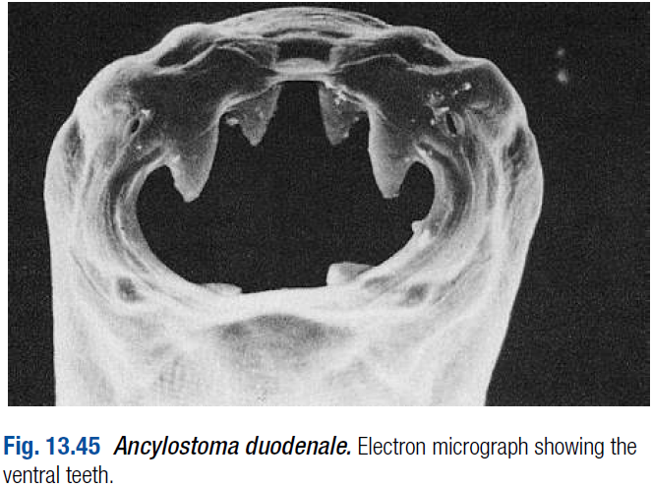
The worms attach themselves to the mucosa of the small intestine by their buccal capsule and withdraw blood.

Slide 8
The mean daily loss of blood from one A. duodenale is 0.15 mL and from N. americanus 0.03 mL.
Hookworm infection is one of the main causes of anaemia in the tropics and subtropics.
A. duodenale is endemic in the Far East and Mediterranean coastal regions, and is also present in Africa, while N. americanus is endemic in West, East and Central Africa, and Central and South America, as well as in the Far East.

Slide 9
Clinical features:
An allergic dermatitis, usually on the feet (ground itch), may be experienced at the time of infection.
The passage of the larvae through the lungs in a heavy infection causes a paroxysmal cough with blood-stained sputum, associated with patchy pulmonary consolidation and eosinophilia.

Slide 10
When the worms have reached the small intestine, vomiting and epigastric pain resembling peptic ulcer disease may occur.
Sometimes frequent loose stools are passed.
The degree of iron and protein deficiency which develops depends not only on the load of worms but also on the nutrition of the patient and especially on the iron stores.

Slide 11
Anaemia with high-output cardiac failure may result.
The mental and physical development of children may be retarded in severe infection.

Slide 12
Investigations:
There is eosinophilia.
The characteristic ovum can be recognised in the stool.
If hookworms are present in numbers sufficient to cause anaemia, faecal occult blood testing will be positive and many ova will be present.

Slide 13
Management:
A single dose of albendazole (400 mg) is the treatment of choice.
Alternatively, mebendazole 100 mg 12-hourly for 3 days may be used.
Anaemia and heart failure associated with hookworm infection respond well to oral iron, even when severe; blood transfusion is rarely required.

Slide 14
Strongyloidiasis:
Strongyloides stercoralis is a very small nematode (2 mm × 0.4 mm) which parasitises the mucosa of the upper part of the small intestine, often in large numbers, causing persistent eosinophilia.
The eggs hatch in the bowel but only larvae are passed in the faeces.
In moist soil they moult and become the infective filariform larvae.

Slide 15
After penetrating human skin, they undergo a development cycle similar to that of hookworms, except that the female worms burrow into the intestinal mucosa and submucosa.
Some larvae in the intestine may develop into filariform larvae, which may then penetrate the mucosa or the perianal skin and lead to autoinfection and persistent infection.

Slide 16
Patients with Strongyloides infection persisting for more than 35 years have been described.
Strongyloidiasis occurs in the tropics and subtropics, and is especially prevalent in the Far East.

Slide 17
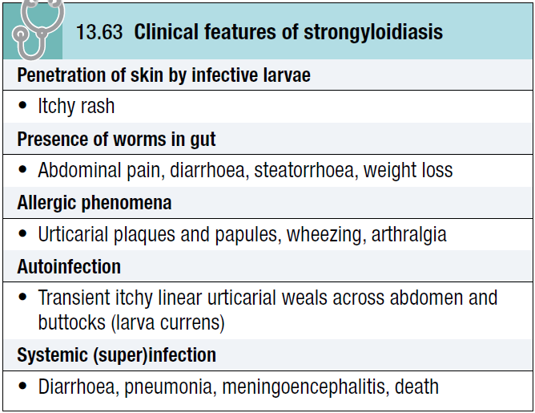
Clinical features:

Slide 18
The classic triad of symptoms consists of abdominal pain, diarrhoea and urticaria.
Cutaneous manifestations, either urticaria or larva currens (a highly characteristic pruritic, elevated, erythematous lesion advancing along the course of larval migration), are characteristic and occur in 66% of patients.

Slide 19
Systemic strongyloidiasis (the Strongyloides hyperinfection syndrome), with dissemination of larvae throughout the body, occurs in association with immune suppression (intercurrent disease, HIV and HTLV-1 infection, corticosteroid treatment).
Patients present with severe, generalised abdominal pain, abdominal distension and shock.

Slide 20
Massive larval invasion of the lungs causes cough, wheeze and dyspnoea; cerebral involvement has manifestations ranging from subtle neurological signs to coma.
Gram-negative sepsis frequently complicates the picture.

Slide 21
Investigations:
There is eosinophilia.
Serology (ELISA) is helpful, but definitive diagnosis depends upon finding the larvae.
The faeces should be examined microscopically for motile larvae; excretion is intermittent so repeated examinations may be necessary.
Larvae can also be found in jejunal aspirate or detected using the string test.
Larvae may also be cultured from faeces.

Slide 22
Management:
Ivermectin 200 μg/kg as a single dose, or two doses of 200 μg/kg on successive days, is effective. Alternatively, albendazole is given orally in a dose of 15 mg/kg body weight 12-hourly for 3 days. A second course may be required.
For the Strongyloides hyperinfection syndrome, ivermectin is given at 200 μg/kg on days 1, 2, 15 and 16.

Slide 23
Ascaris lumbricoides (roundworm):
This pale yellow nematode is 20–35 cm long.
Humans are infected by eating food contaminated with mature ova.
Ascaris larvae hatch in the duodenum, migrate through the lungs, ascend the bronchial tree, are swallowed and mature in the small intestine.

Slide 24
This tissue migration can provoke both local and general hypersensitivity reactions, with pneumonitis, eosinophilic granulomas, bronchial asthma and urticaria.

Slide 25
Clinical features:
Intestinal ascariasis causes symptoms ranging from occasional vague abdominal pain through to malnutrition.
The large size of the adult worm and its tendency to aggregate and migrate can result in obstructive complications.

Slide 26
Tropical and subtropical areas are endemic for ascariasis, and in these areas it causes up to 35% of all intestinal obstructions, most commonly in the terminal ileum.
Obstruction can be complicated further by intussusception, volvulus, haemorrhagic infarction and perforation.
Other complications include blockage of the bile or pancreatic duct and obstruction of the appendix by adult worms.

Slide 27
Investigations:
The diagnosis is made microscopically by finding ova in the faeces.
Adult worms are frequently expelled rectally or orally.
Occasionally, the worms are demonstrated radiographically by a barium examination.
There is eosinophilia.

Slide 28
Management:
A single dose of albendazole (400 mg), pyrantel pamoate (11 mg/kg; maximum 1 g), piperazine (4 g) or mebendazole (100 mg 12-hourly for 3 days) is effective for intestinal ascariasis.
Patients should be warned that they might expel numerous whole, large worms.

Slide 29
Obstruction due to ascariasis should be treated with nasogastric suction, piperazine and intravenous fluids.

Slide 30
Prevention:
Community chemotherapy programmes have been used to reduce Ascaris infection.
The whole community can be treated every 3 months for several years.
Alternatively, schoolchildren can be targeted; treating them lowers the prevalence of ascariasis in the community.

Slide 31
Enterobius vermicularis (threadworm):
This helminth is common throughout the world.
It affects mainly children.
After the ova are swallowed, development takes place in the small intestine, but the adult worms are found chiefly in the colon.

Slide 32
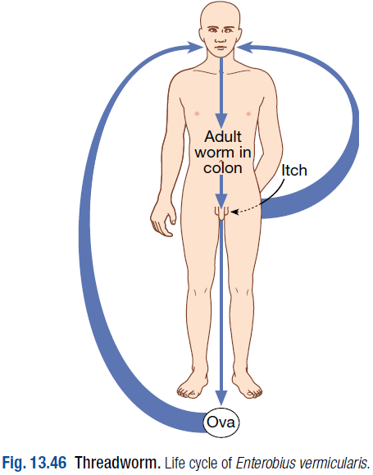
Clinical features:
The gravid female worm lays ova around the anus, causing intense itching, especially at night.
The ova are often carried to the mouth on the fingers and so reinfection or human-to-human infection takes place.

Slide 33
In females the genitalia may be involved.
The adult worms may be seen moving on the buttocks or in the stool.

Slide 34
Investigations:
Ova are detected by applying the adhesive surface of cellophane tape to the perianal skin in the morning. This is then examined on a glass slide under the microscope.
A perianal swab, moistened with saline, is an alternative sampling method.

Slide 35
Management:
A single dose of mebendazole (100 mg), albendazole (400 mg), pyrantel pamoate (11 mg/kg) or piperazine (4 g) is given and may be repeated after 2 weeks to control auto-reinfection.
If infection recurs in a family, each member should be treated as above.

Slide 36
During this period all nightclothes and bed linen are laundered.
Fingernails must be kept short and hands washed carefully before meals.
Subsequent therapy is reserved for those family members who develop recurrent infection.

Slide 37
Trichuris trichiura (whipworm):
Infections with whipworm are common all over the world under unhygienic conditions.
Infection is contracted by the ingestion of earth or food contaminated with ova which have become infective after lying for 3 weeks or more in moist soil.
The adult worm is 3–5 cm long and has a coiled anterior end resembling a whip.

Slide 38
Whipworms inhabit the caecum, lower ileum, appendix, colon and anal canal.
There are usually no symptoms, but intense infections in children may cause persistent diarrhoea or rectal prolapse, and growth retardation.

Slide 39
The diagnosis is readily made by identifying ova in faeces.
Treatment is with mebendazole in doses of 100 mg 12-hourly for 3–5 days or a single dose of albendazole 400 mg.

Slide 40
Tissue-dwelling human nematodes:
Filarial worms are tissue-dwelling nematodes.
The larval stages are inoculated by biting mosquitoes or flies, each specific to a particular filarial species.
The larvae develop into adult worms (2–50 cm long) which, after mating, produce millions of microfilariae (170–320 mm long) that migrate in blood or skin.

Slide 41
The life cycle is completed when the vector takes up microfilariae while feeding on humans.
In the insect, ingested microfilariae develop into infective larvae for inoculation in humans, normally the only host.

Slide 42
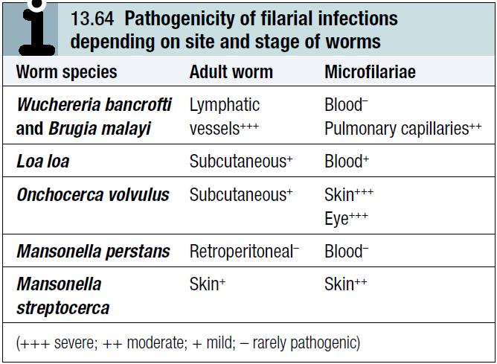
Disease is due to the host’s immune response to the worms (both adult and microfilariae), particularly dying worms, and its pattern and severity vary with the site and stage of each species.

Slide 43
The worms are long-lived; microfilariae survive 2–3 years and adult worms 10–15 years.
The infections are chronic and worst in individuals constantly exposed to reinfection.

Slide 44
Lymphatic filariasis:
Infection with the filarial worms Wuchereria bancrofti and Brugia malayi is associated with clinical outcomes ranging from subclinical infection to hydrocele and elephantiasis.

Slide 45
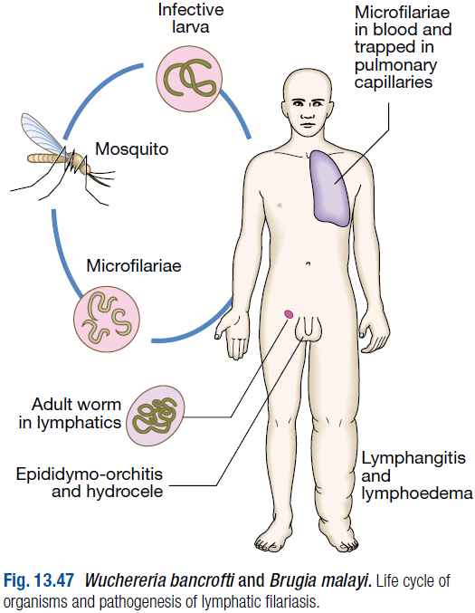
W. bancrofti is transmitted by night-biting culicine or anopheline mosquitoes in most areas.

Slide 46
The adult worms, 4–10 cm in length, live in the lymphatics, and the females produce microfilariae which circulate in large numbers in the peripheral blood, usually at night.
The infection is widespread in tropical Africa, the North African coast, coastal areas of Asia, Indonesia and northern Australia, the South Pacific islands, the West Indies and also in North and South America.

Slide 47
B. malayi is similar to W. bancrofti and is found in Indonesia, Borneo, Malaysia, Vietnam, South China, South India and Sri Lanka.

Slide 48
Pathology:
Several factors contribute to the pathogenesis of lymphatic filariasis.
Toxins released by the adult worm cause lymphangiectasia; this dilatation of the lymphatic vessels leads to lymphatic dysfunction and the chronic clinical manifestations of lymphatic filariasis, lymphoedema and hydrocele.

Slide 49
Death of the adult worm results in acute filarial lymphangitis.
The filariae are symbiotically infected with rickettsia-like bacteria (Wolbachia spp.) and release of lipopolysaccharide from these bacteria contributes to inflammation.

Slide 50
Lymphatic obstruction persists after death of the adult worm.
Secondary bacterial infections cause tissue destruction.
The host response to microfilariae is central to the pathogenesis of tropical pulmonary eosinophilia.

Slide 51
Clinical features:
Acute filarial lymphangitis presents with fever, pain, tenderness and erythema along the course of inflamed lymphatic vessels.
Inflammation of the spermatic cord, epididymis and testis is common.
The whole episode lasts a few days but may recur several times a year.
Temporary oedema becomes more persistent and regional lymph nodes enlarge.

Slide 52
Progressive enlargement, coarsening, corrugation, fissuring and bacterial infection of the skin and subcutaneous tissue develop gradually, causing irreversible ‘elephantiasis’.
The scrotum may reach an enormous size.
Chyluria and chylous effusions are milky and opalescent; on standing, fat globules rise to the top.

Slide 53
The acute lymphatic manifestations of filariasis must be differentiated from thrombophlebitis and infection.
The oedema and lymphatic obstructive changes must be distinguished from congestive cardiac failure, malignancy, trauma and idiopathic abnormalities of the lymphatic system.
Silicates absorbed from volcanic soil can also cause non-filarial elephantiasis.

Slide 54
Tropical pulmonary eosinophilia is a complication seen mainly in India and is likely to be due to microfilariae trapped in the pulmonary capillaries and destroyed by allergic inflammation. Patients present with paroxysmal cough, wheeze and fever.
If untreated, this progresses to debilitating chronic interstitial lung disease.

Slide 55
Investigations:
In the earliest stages of lymphangitis the diagnosis is made on clinical grounds, supported by eosinophilia and sometimes by positive filarial serology.
Filarial infections cause the highest eosinophil counts of all helminthic infections.

Slide 56
Microfilariae can be found in the peripheral blood at night, and either are seen moving in a wet blood film or are detected by microfiltration of a sample of lysed blood.
They are usually present in hydrocele fluid, which may occasionally yield an adult filaria.

Slide 57
By the time elephantiasis develops, microfilariae become difficult to find.
Calcified filariae may sometimes be demonstrable by radiography.
Movement of adult worms can be seen on scrotal ultrasound.
PCR-based tests for detection of W. bancrofti and B. malayi DNA from blood have been developed.

Slide 58
Indirect fluorescence and ELISA detect antibodies in over 95% of active cases and 70% of established elephantiasis. The test becomes negative 1–2 years after cure.
Serological tests cannot distinguish the different filarial infections.

Slide 59
Highly sensitive and specific immunochromatographic card tests for detection of filarial infection are now commercially available; finger prick blood taken at any time of the day can be used for these.

Slide 60
In tropical pulmonary eosinophilia, serology is strongly positive and IgE levels are massively elevated, but circulating microfilariae are not found. The chest X-ray shows miliary changes or mottled opacities. Pulmonary function tests show a restrictive picture.

Slide 61
Management:
Treatment of the individual is aimed at reversing and halting disease progression.
Diethylcarbamazine (DEC) kills microfilariae and adult worms. The dose is 6 mg/ kg daily orally in three divided doses for 12 days.
Most adverse effects seen with DEC treatment are due to the host response to dying microfilariae, and the reaction intensity is directly proportional to the microfilarial load.

Slide 62
The main symptoms are fever, headache, nausea, vomiting, arthralgia and prostration. These usually occur within 24–36 hours of the first dose of DEC.
Antihistamines or corticosteroids may be required to control these allergic phenomena.
Both the 12-day course and a single dose of DEC reduce microfilaria levels by about 90% 6–12 months after treatment.

Slide 63
No carefully controlled trials have evaluated the effects of DEC treatment alone on the chronic manifestations of lymphatic filariasis.
A single dose of either ivermectin (200 μg/kg) or albendazole (400 mg) in combination with DEC (300 mg) also eliminates microfilariae for 1 year.

Slide 64
With the discovery of an endosymbiotic bacterium, Wolbachia, in most of the filarial worms, there is a possible role for doxycycline in eliminating the bacteria; the drug leads to interruption of embryogenesis and hence the production of microfilariae.

Slide 65
For tropical pulmonary eosinophilia, DEC (6 mg/kg daily orally in three divided doses for 14 days) is the treatment of choice.

Slide 66
Chronic lymphatic pathology:
Experience in India and Brazil shows that active management of chronic lymphatic pathology can alleviate symptoms.
Patients should be taught meticulous skin care of their lymphoedematous limbs to prevent secondary bacterial and fungal infections.

Slide 67
Tight bandaging, massage and bed rest with elevation of the affected limb may help to control the lymphoedema.
Prompt diagnosis and antibiotic therapy of bacterial cellulitis are important in preventing further lymphatic damage and worsening of existing elephantiasis.

Slide 68
Plastic surgery may be indicated in established elephantiasis.
Great relief can be obtained by removal of excess tissue but recurrences are probable unless new lymphatic drainage is established.
Hydroceles and chyluria can be repaired surgically.

Slide 69
Prevention:
Treatment of the whole population in endemic areas with annual single-dose DEC (6 mg/kg), either alone or in combination with albendazole or ivermectin, can reduce filarial transmission.
This mass treatment should be combined with mosquito control programmes.

Slide 70
Loiasis:
Loiasis is caused by infection with the filaria Loa loa.
The adults, 3–7 cm × 4 mm, chiefly parasitise the subcutaneous tissue of humans, releasing larval microfilariae into the peripheral blood in the daytime.
The vector is Chrysops, a forest-dwelling, day-biting fly.

Slide 71
The host response to Loa loa is usually absent or mild, so that the infection may be harmless.
From time to time a short-lived, inflammatory, oedematous swelling (a Calabar swelling) is produced around an adult worm.
Heavy infections, especially when treated, may cause encephalitis.

Slide 72
Clinical features:
The infection is often symptomless.
The incubation period is commonly over a year but may be just 3 months.
The first sign is usually a Calabar swelling, an irritating, tense, localised swelling that may be painful, especially if it is near a joint.

Slide 73
The swelling is generally on a limb; it measures a few centimetres in diameter but sometimes is more diffuse and extensive. It usually disappears after a few days but may persist for 2 or 3 weeks.
A succession of such swellings may appear at irregular intervals, often in adjacent sites.

Slide 74
Sometimes there is urticaria and pruritus elsewhere.
Occasionally, a worm may be seen wriggling under the skin, especially that of an eyelid, and may cross the eye under the conjunctiva, taking many minutes to do so.

Slide 75
Investigations:
Diagnosis is by demonstrating microfilariae in blood taken during the day, but they may not always be found in patients with Calabar swellings.
Antifilarial antibodies are positive in 95% of patients and there is massive eosinophilia.
Occasionally, a calcified worm may be seen on X-ray.

Slide 76
Management:
DEC is curative, in a dose of 9–12 mg/kg daily which is continued for 21 days.
Treatment may precipitate a severe reaction in patients with a heavy microfilaraemia characterised by fever, joint and muscle pain, and encephalitis; microfilaraemic patients should be given corticosteroid cover.

Slide 77
Prevention:
Protection is afforded by building houses away from trees and by having dwellings wire-screened.
Protective clothing and insect repellents are also useful.
DEC in a dose of 5 mg/kg daily for 3 days each month is partially protective.

Slide 78
Onchocerciasis (river blindness):
Onchocerciasis is the result of infection by the filarial Onchocerca volvulus.
The infection is conveyed by flies of the genus Simulium, which breed in rapidly flowing, well-aerated water.
Adult flies inflict painful bites during the day, both inside and outside houses.

Slide 79
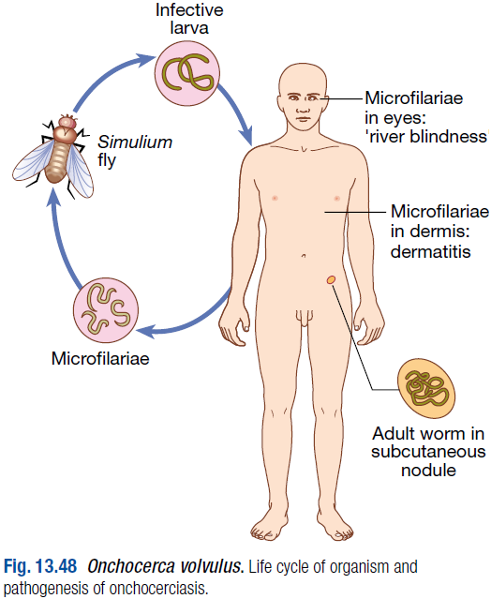
While feeding, they pick up the microfilariae, which mature into the infective larva and are transmitted to a new host in subsequent bites.
Humans are the only known hosts

Slide 80
Onchocerciasis is endemic in sub-Saharan Africa, Yemen, and a few foci in Central and South America.
It is estimated that 17.7 million people are infected, of whom 500 000 are visually impaired and 270 000 blind.
Due to onchocerciasis huge tracts of fertile land lie virtually untilled, and individuals and communities are impoverished.

Slide 81
Pathology:
After inoculation of larvae by a bite from an infected fly, the worms mature in 2–4 months and live for up to 17 years in subcutaneous and connective tissues.
At sites of trauma, over bony prominences and around joints, fibrosis may form nodules around adult worms which otherwise cause no direct damage.

Slide 82
Innumerable microfilariae, discharged by the female O. volvulus, move actively in these nodules and in the adjacent tissues, are widely distributed in the skin, and may invade the eye.

Slide 83
Live microfilariae elicit little tissue reaction, but dead ones may cause severe allergic inflammation leading to hyaline necrosis and loss of collagen and elastin.
Death of microfilariae in the eye causes inflammation and may lead to blindness.

Slide 84
Clinical features:
The infection may remain symptomless for months or years.
The first symptom is usually itching, localised to one quadrant of the body and later becoming generalised and involving the eyes.
Transient oedema of part or all of a limb is an early sign, followed by papular urticaria spreading gradually from the site of infection.

Slide 85
This is difficult to see on dark skins, in which the most common signs are papules excoriated by scratching, spotty hyperpigmentation from resolving inflammation, and more chronic changes of a rough, thickened or inelastic, wrinkled skin.

Slide 86
Both infected and uninfected superficial lymph nodes enlarge and may hang down in folds of loose skin at the groins.
Hydrocele, femoral hernias and scrotal elephantiasis can occur.
Firm subcutaneous nodules > 1 cm in diameter (onchocercomas) occur in chronic infection.

Slide 87
Eye disease is most common in highly endemic areas and is associated with chronic heavy infections and nodules on the head.
Early manifestations include itching, lacrimation and conjunctival injection. These lead to conjunctivitis, sclerosing keratitis with pannus formation, uveitis which may lead to glaucoma and cataract, and, less commonly, choroiditis and optic neuritis. Classically, ‘snowflake’ deposits are seen in the edges of the cornea.

Slide 88
Investigations:
The finding of nodules or characteristic lesions of the skin or eyes in a patient from an endemic area, associated with eosinophilia, is suggestive.

Slide 89
Skin snips or shavings, taken with a corneoscleral punch or scalpel blade from calf, buttock and shoulder, are placed in saline under a cover slip on a microscope slide and examined after 4 hours. Microfilariae are seen wriggling free in all but the lightest infections.

Slide 90
Slit-lamp examination may reveal microfilariae moving in the anterior chamber of the eye or trapped in the cornea.
A nodule may be removed and incised, showing the coiled, thread-like adult worm.

Slide 91
Filarial antibodies may be detected in up to 95% of patients.
Several promising rapid strip tests based on antibody or antigen detection are under clinical evaluation.
In patients with strong suspicion of onchocerciasis but negative tests, a provocative Mazzotti test, in which administration of 0.5–1.0 mg/kg of DEC exacerbates pruritus or dermatitis, strongly suggests onchocerciasis.

Slide 92
Management:
Ivermectin, in a single dose of 100–200 μg/kg, repeated several times at 3-monthly intervals to prevent relapses, is recommended. It kills microfilariae, and is non-toxic and does not trigger severe reactions.

Slide 93
In the rare event of a severe reaction causing oedema or postural hypotension, prednisolone 20–30 mg may be given daily for 2 or 3 days.
Eradication of Wolbachia with doxycycline (100 mg daily for 6 weeks) prevents reproduction of the worm.

Slide 94
Prevention:
Mass treatment with ivermectin is practised. It reduces morbidity in the community and prevents eye disease from getting worse.
Simulium can be destroyed in its larval stage by the application of insecticide to streams.
Long trousers, skirts and sleeves discourage the fly from biting.

Slide 95
Dracunculiasis (Guinea worm):
Infestation with the Guinea worm Dracunculus medinensis manifests itself when the female worm, over a metre long, emerges from the skin.
Humans are infected by ingesting a small crustacean, Cyclops, which inhabits wells and ponds, and contains the infective larval stage of the worm.

Slide 96
The worm was widely distributed across Africa and the Middle East but after a successful eradication programme is now seen only in sub-Saharan Africa.

Slide 97
Management and prevention:
Traditionally, the protruding worm is extracted by winding it out gently over several days on a matchstick.
The worm must never be broken.
Antibiotics for secondary infection and prophylaxis of tetanus are also required.

Slide 98
A global elimination campaign is based on the provision of clean drinking water and eradication of water fleas from drinking water. The latter is being achieved by simple filtration of water through a plastic mesh filter and chemical treatment of water supplies.

Slide 99
Other filariases:
Mansonella perstans:
This filarial worm is transmitted by the midges Culicoides austeni and C. grahami.
It is common throughout equatorial Africa as far south as Zambia, and also in Trinidad and parts of northern and eastern South America.

Slide 100
M. perstans has never been proven to cause disease but it may be responsible for a persistent eosinophilia and occasional allergic manifestations.
M. perstans is resistant to ivermectin and DEC, and the infection may persist for many years.

Slide 101
Dirofilaria immitis:
This dog heart worm infects humans, causing skin and lung lesions.
It is not uncommon in the USA, Japan and Australia.

Slide 102
Zoonotic nematodes:
Trichinosis (trichinellosis):
Trichinella spiralis is a nematode that parasitises rats and pigs, and is only transmitted to humans if they eat partially cooked infected pork, usually as sausage or ham. Bear meat is another source.

Slide 103
Symptoms result from invasion of intestinal submucosa by ingested larvae, which develop into adult worms, and the secondary invasion of striated muscle by fresh larvae produced by these adult worms.
Outbreaks have occurred in the UK, as well as in other countries where pork is eaten.

Slide 104
Clinical features:
The clinical features of trichinosis are determined by the larval numbers.
A light infection with a few worms may be asymptomatic; a heavy infection causes nausea and diarrhoea 24–48 hours after the infected meal.

Slide 105
A few days later, the symptoms associated with larval invasion predominate: there is fever and oedema of the face, eyelids and conjunctivae; invasion of the diaphragm may cause pain, cough and dyspnoea; and involvement of the muscles of the limbs, chest and mouth causes stiffness, pain and tenderness in affected muscles.

Slide 106
Larval migration may cause acute myocarditis and encephalitis.
An eosinophilia is usually found after the 2nd week.
An intense infection may prove fatal but those who survive recover completely.

Slide 107
Investigations:
Commonly, a group of people who have eaten infected pork from a common source develop symptoms at about the same time.
Biopsy from the deltoid or gastrocnemius after the 3rd week of symptoms in suspected cases may reveal encysted larvae.
Serological tests are also helpful.

Slide 108
Management:
Treatment is with albendazole 20 mg/kg daily for 7 days. Given early in the infection, this may kill newly formed adult worms in the submucosa and thus reduce the number of larvae reaching the muscles.
Corticosteroids are necessary to control the serious effects of acute inflammation.

Slide 109
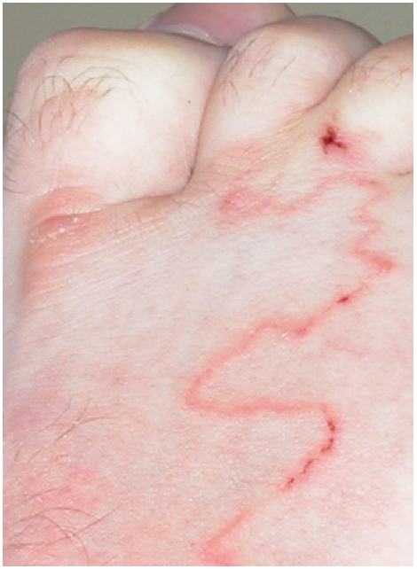
Cutaneous larva migrans (CLM):
CLM is the most common linear lesion seen in travellers.

Slide 110
Intensely pruritic, linear, serpiginous lesions result from the larval migration of the dog hookworm (Ancylostoma caninum).
The track moves across the skin at a rate of 2–3 cm/day. This contrasts with the rash of Strongyloides , which is fast-moving and transient.
Although the larvae of dog hookworms frequently infect humans, they do not usually develop into the adult form.

Slide 111
The most common site for CLM is the foot but elbows, breasts and buttocks may be affected.
Most patients with CLM have recently visited a beach where the affected part was exposed.
The diagnosis is clinical.

Slide 112
Treatment may be local with 12-hourly application of 15% thiabendazole cream, or systemic with a single dose of albendazole (400 mg) or ivermectin (150–200 μg/kg).

Slide 113
Trematodes (flukes):
These leaf-shaped worms are parasitic to humans and animals.
Their complex life cycles may involve one or more intermediate hosts, often freshwater molluscs.

Slide 114
Schistosomiasis:
Schistosomiasis is one of the most important causes of morbidity in the tropics.
There are five species of the genus Schistosoma which commonly cause disease in humans: S. haematobium, S. mansoni, S. japonicum, S. mekongi and S. intercalatum.

Slide 115
S. haematobium was discovered by Theodor Bilharz in Cairo in 1861 and the disease is sometimes called bilharzia or bilharziasis.
Schistosome eggs have been found in Egyptian mummies dated 1250 BC.

Slide 116
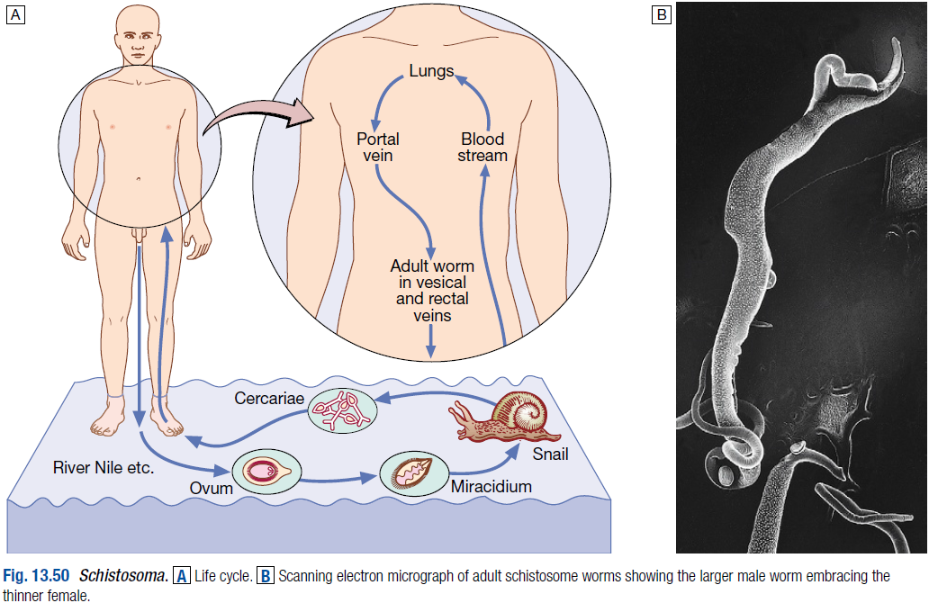

Slide 117
The ovum is passed in the urine or faeces of infected individuals and gains access to fresh water, where the ciliated miracidium inside it is liberated; it enters its intermediate host, a species of freshwater snail, in which it multiplies.

Slide 118
Large numbers of fork-tailed cercariae are then liberated into the water, where they may survive for 2–3 days.
Cercariae can penetrate the skin or the mucous membrane of the mouth of humans.

Slide 119
They transform into schistosomulae and moult as they pass through the lungs; thence they are carried by the blood stream to the liver, and so to the portal vein, where they mature.

Slide 120
The male worm is up to 20 mm in length and the more slender cylindrical female, usually enfolded longitudinally by the male, is rather longer.
Within 4–6 weeks of infection they migrate to the venules draining the pelvic viscera, where the females deposit ova.

Slide 121
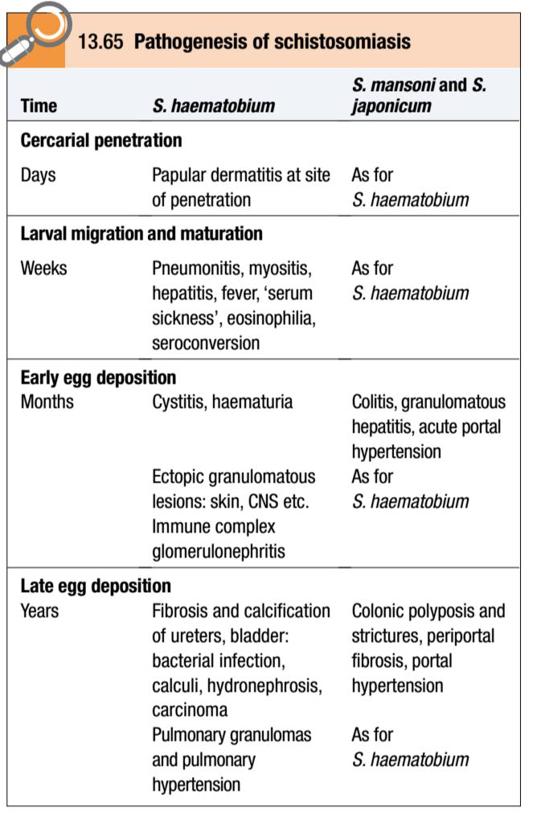
Pathology:
This depends on the species and the stage of infection.

Slide 122
Most disease is due to the passage of eggs through mucosa and to the granulomatous reaction to eggs deposited in tissues.
The eggs of S. haematobium pass mainly through the wall of the bladder, but may also involve rectum, seminal vesicles, vagina, cervix and uterine tubes.

Slide 123
S. mansoni and S. japonicum eggs pass mainly through the wall of the lower bowel or are carried to the liver.
The most serious, although rare, site of ectopic deposition of eggs is in the CNS.
Granulomas are composed of macrophages, eosinophils, and epithelioid and giant cells around an ovum.

Slide 124
Later there is fibrosis and eggs calcify, often in sufficient numbers to become radiologically visible.
Eggs of S. haematobium may leave the vesical plexus and be carried directly to the lung.

Slide 125
Those of S. mansoni and S. japonicum may also reach the lungs after the development of portal hypertension and consequent portasystemic collateral circulation.
In both circumstances egg deposition in the pulmonary vasculature, and the resultant host response, can lead to the development of pulmonary hypertension.

Slide 126
Clinical features:
Recent travellers, especially those overlanding through Africa, may present with allergic manifestations and eosinophilia; residents of schistosomiasis-endemic areas are more likely to present with chronic urinary tract pathology or portal hypertension.

Slide 127
During the early stages of infection there may be itching lasting 1–2 days at the site of cercarial penetration.
After a symptom-free period of 3–5 weeks, acute schistosomiasis (Katayama syndrome) may present with allergic manifestations such as urticaria, fever, muscle aches, abdominal pain, headaches, cough and sweating.

Slide 128
On examination hepatomegaly, splenomegaly, lymphadenopathy and pneumonia may be present.
These allergic phenomena may be severe in infections with S. mansoni and S. japonicum, but are rare with S. haematobium.
The features subside after 1–2 weeks.

Slide 129
Chronic schistosomiasis is due to egg deposition and occurs months to years after infection. The symptoms and signs depend upon the intensity of infection and the species of infecting schistosome.

Slide 130
Schistosoma haematobium:
Humans are the only natural hosts of S. haematobium, which is highly endemic in Egypt and East Africa, and occurs throughout Africa and the Middle East.
Infection can be acquired after a brief exposure, such as swimming in freshwater lakes in Africa.

Slide 131
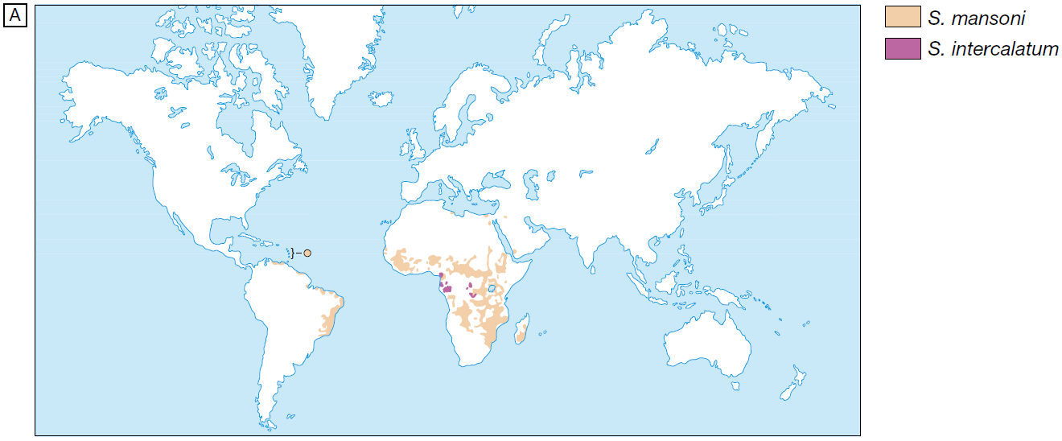

Slide 132
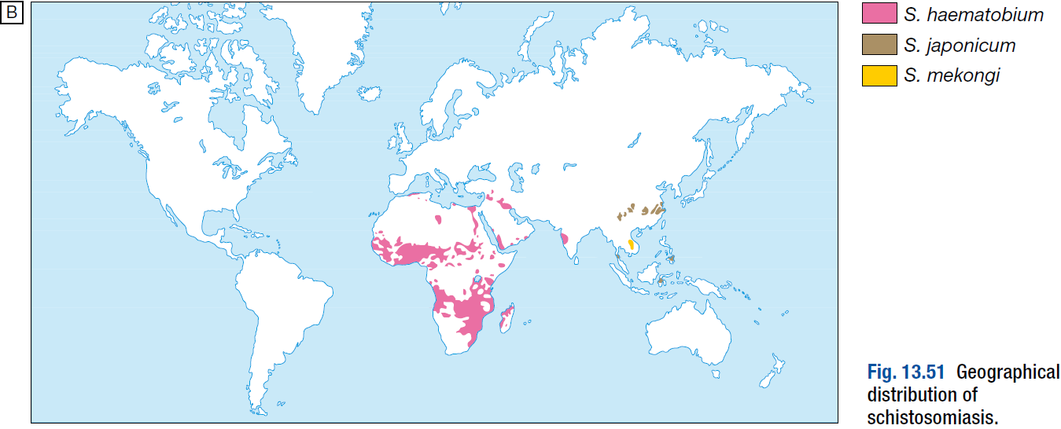

Slide 133
Painless terminal haematuria is usually the first and most common symptom.
Frequency of micturition follows, due to bladder neck obstruction.
Later the disease may be complicated by frequent urinary tract infections, bladder or ureteric stone formation, hydronephrosis, and ultimately renal failure with a contracted calcified bladder.

Slide 134
Pain is often felt in the iliac fossa or in the loin, and radiates to the groin.
In several endemic areas there is a strong epidemiological association of S. haematobium infection with squamous cell carcinoma of the bladder.

Slide 135
Disease of the seminal vesicles may lead to haemospermia.
Females may develop schistosomal papillomas of the vulva, and schistosomal lesions of the cervix may be mistaken for cancer.
Intestinal symptoms may follow involvement of the bowel wall.
Ectopic worms cause skin or spinal cord lesions.

Slide 136
The severity of S. haematobium infection varies greatly, and many with a light infection are asymptomatic.
However, as adult worms can live for 20 years or more and lesions may progress, these patients should always be treated.

Slide 137
Schistosoma mansoni:
S. mansoni is endemic throughout Africa, the Middle East, Venezuela, Brazil and the Caribbean.
Characteristic symptoms begin 2 months or more after infection.
They may be slight, no more than malaise, or consist of abdominal pain and frequent stools which contain blood-stained mucus.

Slide 138
With severe advanced disease, increased discomfort from rectal polyps may be experienced.
The early hepatomegaly is reversible, but portal hypertension may cause massive splenomegaly, fatal haematemesis from oesophageal varices, or progressive ascites.
Liver function is initially preserved because the pathology is fibrotic rather than cirrhotic.

Slide 139
S. mansoni and other schistosoma infections predispose to the carriage of Salmonella, in part because Salmonella may attach to the schistosomes and in part because shared antigens on schistosomes may induce immunological tolerance to Salmonella.

Slide 140
Schistosoma japonicum, S. mekongi and S. intercalatum:
In addition to humans, the adult worm of S. japonicum infects the dog, rat, field mouse, water buffalo, ox, cat, pig, horse and sheep.
Although other Schistosoma spp. Can infect species other than humans, the non-human reservoir seems to be particularly important in transmission for S. japonicum but not for S. haematobium or S. mansoni.

Slide 141
S. japonicum is prevalent in the Yellow River and Yangtze–Jiang basins in China, where the infection is a major public health problem. It also has a focal distribution in the Philippines, Indonesia and Thailand.
The related S. mekongi occurs in Laos, Thailand and Myanmar, and S. intercalatum in West and Central Africa.

Slide 142
The pathology of S. japonicum is similar to that of S. mansoni, but as this worm produces more eggs, the lesions tend to be more extensive and widespread.
The clinical features resemble those of severe infection with S. mansoni, with added neurological features.

Slide 143
The small and large bowel may be affected, and hepatic fibrosis with splenic enlargement is usual.
Deposition of eggs or worms in the CNS, especially in the brain or spinal cord, causes symptoms in about 5% of infections, notably epilepsy, blindness, hemiplegia or paraplegia.

Slide 144
Investigations:
There is marked eosinophilia.
Serological tests (ELISA) are useful as screening tests but remain positive after chemotherapeutic cure.

Slide 145
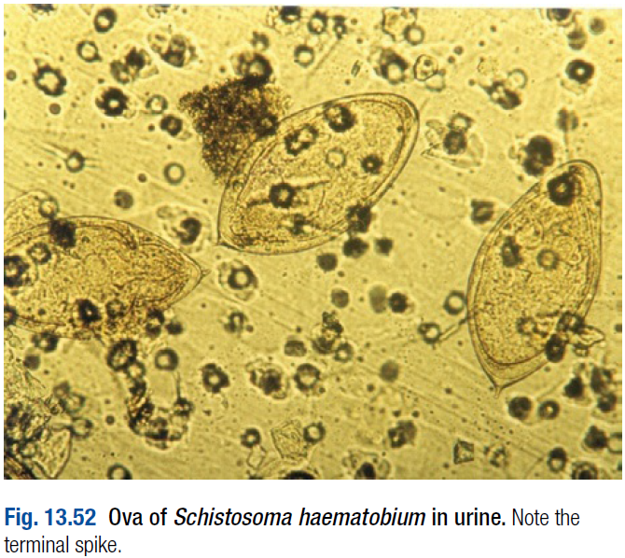
In S. haematobium infection, dipstick urine testing shows blood and albumin. The eggs can be found by microscopic examination of the centrifuged deposit of terminal stream urine.

Slide 146
Ultrasound is useful for assessing the urinary tract; bladder wall thickening, hydronephrosis and bladder calcification can be detected.
Cystoscopy reveals ‘sandy’ patches, bleeding mucosa and later distortion.

Slide 147
In a heavy infection with S. mansoni or S. japonicum the characteristic egg with its lateral spine can usually be found in the stool.
When the infection is light or of long duration, a rectal biopsy can be examined.
Sigmoidoscopy may show inflammation or bleeding.
Biopsies should be examined for ova.

Slide 148
Management:
The object of specific treatment is to kill the adult schistosomes and so stop egg-laying.
Praziquantel is the drug of choice for all forms of schistosomiasis. The drug produces parasitological cure in 80% of treated individuals and over 90% reduction in egg counts in the remainder.

Slide 149
Side-effects are uncommon but include nausea and abdominal pain.
Praziquantel therapy in early infection reverses pathologies such as hepatomegaly and bladder wall thickening and granulomas.

Slide 150
Surgery may be required to deal with residual lesions such as ureteric stricture, small fibrotic urinary bladders, or granulomatous masses in the brain or spinal cord.
Removal of rectal papillomas by diathermy or by other means may provide symptomatic relief.

Slide 151
Prevention:
So far no satisfactory single means of controlling schistosomiasis has been established.
The life cycle is terminated if the ova in urine or faeces are not allowed to contaminate fresh water containing the snail host.
The provision of latrines and of a safe water supply, however, remains a major problem in rural areas throughout the tropics.

Slide 152
Furthermore, S. japonicum has so many hosts besides humans that latrines would be of little avail.
Annual mass treatment of the population helps against S. haematobium and S. mansoni, but this method has so far had little success with S. japonicum.

Slide 153
Attack on the intermediate host, the snail, presents many difficulties and has not on its own proved successful on any scale. For personal protection, contact with infected water must be avoided.

Slide 154
Liver flukes:
Liver flukes infect at least 20 million people and remain an important public health problem in many endemic areas.
They are associated with abdominal pain, hepatomegaly and relapsing cholangitis.
Clonorchis sinensis is a major aetiological agent of bile duct cancer.

Slide 155
The three major liver flukes have similar life cycles and pathologies.
Other flukes of medical importance include lung and intestinal flukes

Slide 156
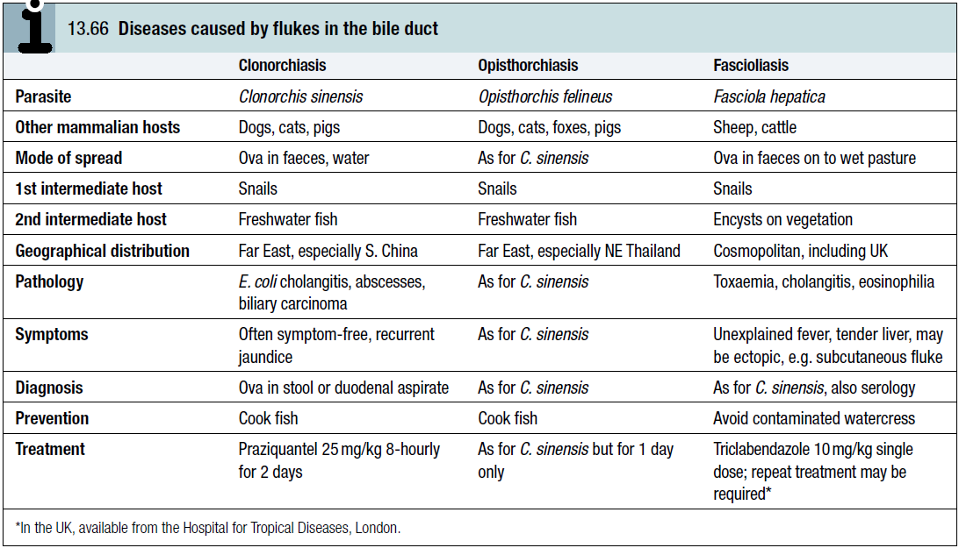

Slide 157
Cestodes (tapeworms):
Cestodes are ribbon-shaped worms which inhabit the intestinal tract.
They have no alimentary system and absorb nutrients through the tegumental surface.
The anterior end, or scolex, has suckers for attaching to the host.

Slide 158
From the scolex arises a series of progressively developing segments, the proglottides, which, when shed, may continue to show active movements.
Cross-fertilisation takes place between segments.

Slide 159
Ova, present in large numbers in mature proglottides, remain viable for weeks and during this period they may be consumed by the intermediate host.
Larvae liberated from the ingested ova pass into the tissues, forming larval cysticerci.
Tapeworms cause two distinct patterns of disease, either intestinal infection or systemic cysticercosis.

Slide 160
Taenia saginata (beef tapeworm) and Diphyllobothrium latum (fish tapeworm) cause only intestinal infection, following human ingestion of intermediate hosts that contain cysticerci (the larval stage of the tapeworm).

Slide 161
Taenia solium causes intestinal infection if a cysticerci-containing intermediate host is ingested, and cysticercosis (systemic infection from larval migration) if ova are ingested.

Slide 162
Echinococcus granulosus (dog tapeworm) does not cause human intestinal infection, but causes hydatid disease (which is analogous to cysticercosis) following ingestion of ova and subsequent larval migration.

Slide 163
Intestinal tapeworm:
Humans acquire tapeworm by eating undercooked beef infected with the larval stage of T. saginata, undercooked pork containing the larval stage of T. solium, or undercooked freshwater fish containing larvae of D. latum.
Usually only one adult tapeworm is present in the gut but up to ten have been reported.

Slide 164
The ova of T. saginata and T. solium are indistinguishable microscopically.
However, examination of scolex and proglottides can differentiate between them.

Slide 165
T. solium has a rostellum and two rows of hooklets on the scolex, and discharges multiple proglottides (3–5) attached together with lower degrees of uterine branching (approximately 10); T. saginata has only four suckers in its scolex, and discharges single proglottids with greater uterine branching (up to 30).

Slide 166
Taenia saginata:
Infection with T. saginata occurs in all parts of the world.
The adult worm may be several metres long and produces little or no intestinal upset in human beings, but knowledge of its presence, by noting segments in the faeces or on underclothing, may distress the patient.

Slide 167
Ova may be found in the stool.
Praziquantel is the drug of choice; niclosamide or nitazoxanide are alternatives.
Prevention depends on efficient meat inspection and the thorough cooking of beef.

Slide 168
Taenia solium:
T. solium, the pork tapeworm, is common in central Europe, South Africa, South America and parts of Asia.
It is not as large as T. saginata.

Slide 169
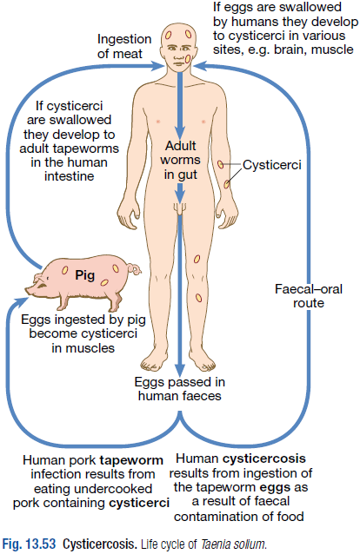
The adult worm is found only in humans following the eating of undercooked pork containing cysticerci.

Slide 170
Niclosamide, followed by a mild laxative (after 1–2 hours) to prevent retrograde intestinal autoinfection, is effective for intestinal infection.
Cooking pork well prevents intestinal infection.
Great care must be taken by nurses and other adults while attending a patient harbouring an adult worm to avoid ingestion of ova or segments.

Slide 171
Cysticercosis:
Human cysticercosis is acquired by ingesting T. solium tapeworm ova, from either contaminated fingers or food.
The larvae are liberated from eggs in the stomach, penetrate the intestinal mucosa and are carried to many parts of the body where they develop and form cysticerci, 0.5–1 cm cysts that contain the head of a young worm.
They do not grow further or migrate.
Common locations are the subcutaneous tissue, skeletal muscles and brain.

Slide 172
Clinical features:
When superficially placed, cysts can be palpated under the skin or mucosa as pea-like ovoid bodies.
Here they cause few or no symptoms, and will eventually die and become calcified.

Slide 173
Heavy brain infections, especially in children, may cause features of encephalitis.
More commonly, however, cerebral signs do not occur until the larvae die, 5–20 years later.
Epilepsy, personality changes, staggering gait or signs of internal hydrocephalus are the most common features.

Slide 174
Investigations:
Calcified cysts in muscles can be recognised radiologically.
In the brain, however, less calcification takes place and larvae are only occasionally visible by plain X-ray; usually CT or MRI will show them.
Epileptic fits starting in adult life suggest the possibility of cysticercosis if the patient has lived in or travelled to an endemic area.

Slide 175
The subcutaneous tissue should be palpated and any nodule excised for histology.
Radiological examination of the skeletal muscles may be helpful.
Antibody detection is available for serodiagnosis.

Slide 176
Management and prevention:
Albendazole, 15 mg/kg daily for a minimum of 8 days, has now become the drug of choice for parenchymal neurocysticercosis.
Praziquantel is another option, 50 mg/kg in three divided doses daily for 10 days.
Prednisolone, 10 mg 8-hourly, is also given for 14 days, starting 1 day before the albendazole or praziquantel.

Slide 177
In addition, anti-epileptic drugs should be given until the reaction in the brain has subsided.
Operative intervention is indicated for hydrocephalus.
Studies from India and Peru suggest that most small solitary cerebral cysts will resolve without treatment.

Slide 178
Echinococcus granulosus (Taenia echinococcus) and hydatid disease:
Dogs are the definitive hosts of the tiny tapeworm E. granulosus.
The larval stage, a hydatid cyst, normally occurs in sheep, cattle, camels and other animals that are infected from contaminated pastures or water.
By handling a dog or drinking contaminated water, humans may ingest eggs.

Slide 179
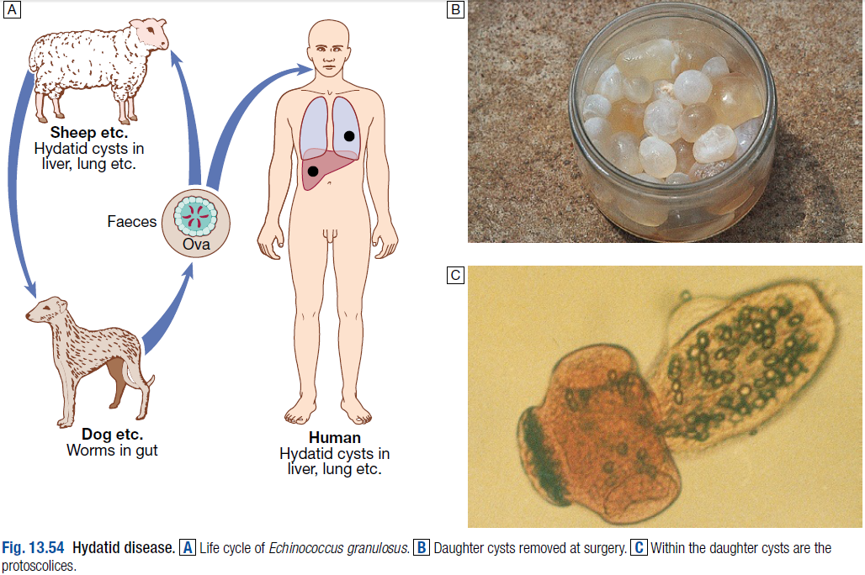

Slide 180
The embryo is liberated from the ovum in the small intestine and gains access to the blood stream and thus to the liver.
The resultant cyst grows very slowly, sometimes intermittently.
It is composed of an enveloping fibrous pericyst, laminated hyaline membrane (ectocyst) and inner germinal layers (endocyst) which gives rise to daughter cysts, or germinating cystic brood capsule in which larvae (protoscolices) develop.

Slide 181
Over time some cysts may calcify and become non-viable.
The disease is common in the Middle East, North and East Africa, Australia and Argentina. Foci of infection persist in rural Wales and Scotland.

Slide 182
E. multilocularis, which has a cycle between foxes and voles, causes a similar but more severe infection, ‘alveolar hydatid disease’, which invades the liver like cancer.

Slide 183
Clinical features:
A hydatid cyst is typically acquired in childhood and may, after growing for some years, cause pressure symptoms. These vary, depending on the organ or tissue involved.
In nearly 75% of patients with hydatid disease the right lobe of the liver is invaded and contains a single cyst.
In others a cyst may be found in lung, bone, brain or elsewhere.

Slide 184
Investigations:
The diagnosis depends on the clinical, radiological and ultrasound findings in a patient who has lived in close contact with dogs in an endemic area.
Complement fixation and ELISA are positive in 70–90% of patients.

Slide 185
Management and prevention:
Hydatid cysts should be excised wherever possible.
Great care is taken to avoid spillage and cavities are sterilised with 0.5% silver nitrate or 2.7% sodium chloride.

Slide 186
Albendazole (400 mg 12-hourly for 3 months) should also be used. The drug is now often combined with PAIR (percutaneous puncture, aspiration, injection of scolicidal agent and re-aspiration) to good effect.
Praziquantel 20 mg/kg 12-hourly for 14 days also kills protoscolices perioperatively.

Slide 187
Prevention is difficult in situations where there is a close association with dogs and sheep.
Personal hygiene, satisfactory disposal of carcasses, meat inspection and deworming of dogs can greatly reduce the prevalence of disease.

Slide 188
Other tapeworms:
There are many other cestodes whose adult or larval stages may infect humans.
Sparganosis is a condition in which an immature worm develops in humans, usually subcutaneously, as a result of eating or applying to the skin the secondary or tertiary intermediate host.

Slide 189
ECTOPARASITES
Ectoparasites only interact with the outermost surfaces of the host.

Slide 190
Jiggers (tungiasis):
This is widespread in tropical America and Africa, and is caused by the sand flea Tunga penetrans.
The pregnant flea burrows into the skin around toes and produces large numbers of eggs.
The burrows are intensely irritating and the whole inflammatory nodule should be removed with a sterile needle.
Secondary infection of tunga lesions is common.

Slide 191
Myiasis:
Myiasis is due to skin infestation with larvae of the South American botfly, Dermatobia hominis, or the African Tumbu fly, Cordylobia anthropophaga.
The larvae develop in a subcutaneous space with a central sinus. This orifice is the air source for the larvae, and periodically the larval respiratory spiracles protrude through the sinus.

Slide 192
Patients with myiasis feel movement within the larval burrow and can experience intermittent sharp, lancinating pains.
Myiasis is diagnosed clinically and should be suspected with any furuncular lesion accompanied by pain and a crawling sensation in the skin.

Slide 193
The larva may be suffocated by blocking the respiratory orifice with petroleum jelly and gently removing it with tweezers.
Secondary infection of myiasis is remarkably infrequent and rapid healing follows removal of intact larvae.

Slide 194
END

